Slide 1
K-Means Clustering
Dr. Rattapol Kasemrat

Slide 2
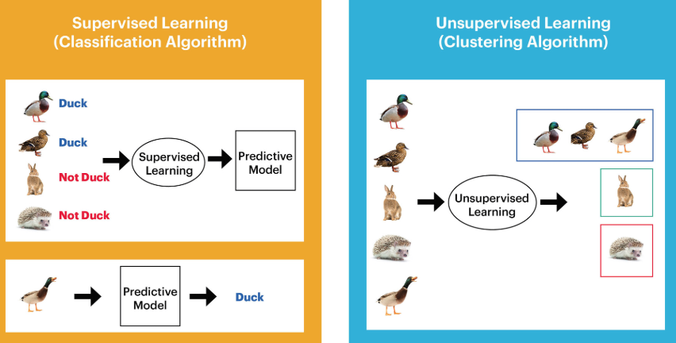
Supervised machine learning vs Unsupervised machine learning

Slide 3
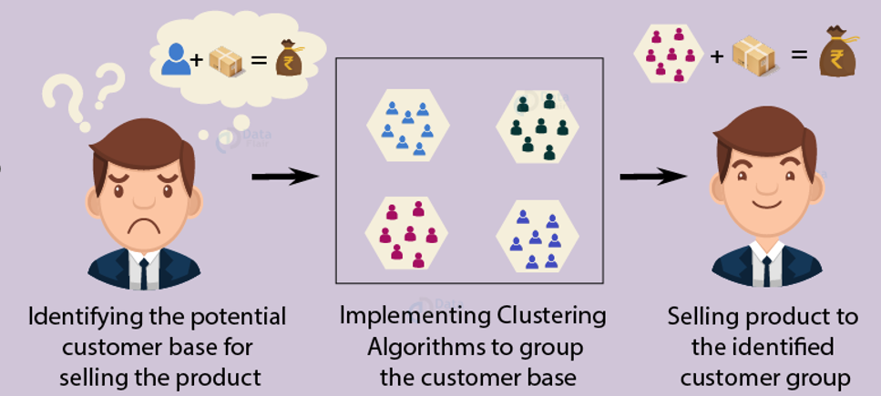
Customer Segmentation (using machine learning algorithms)

Slide 4
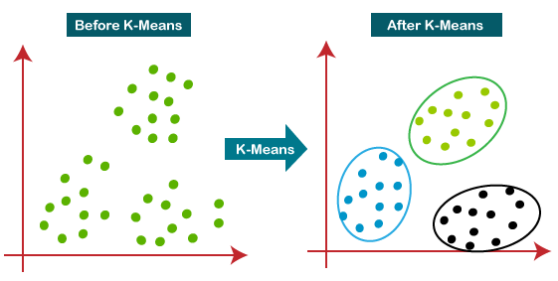
K-Means:

Slide 5
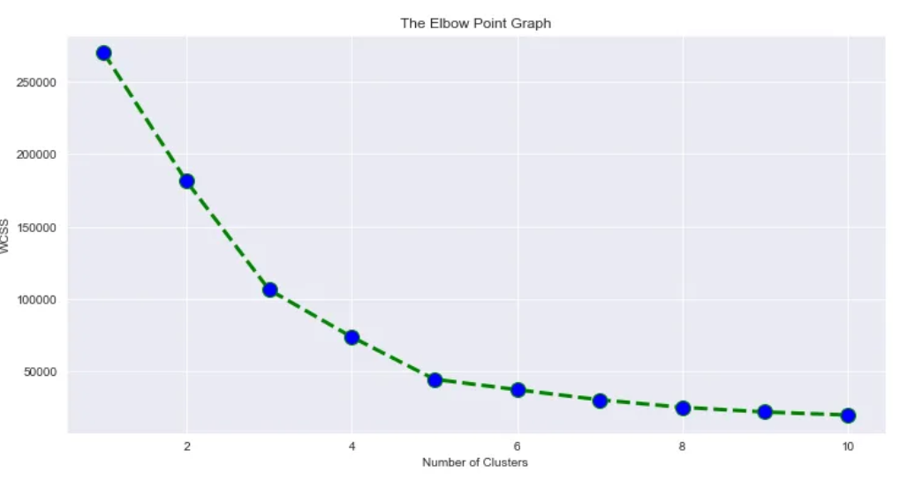
K-Mean clustering:

Slide 6
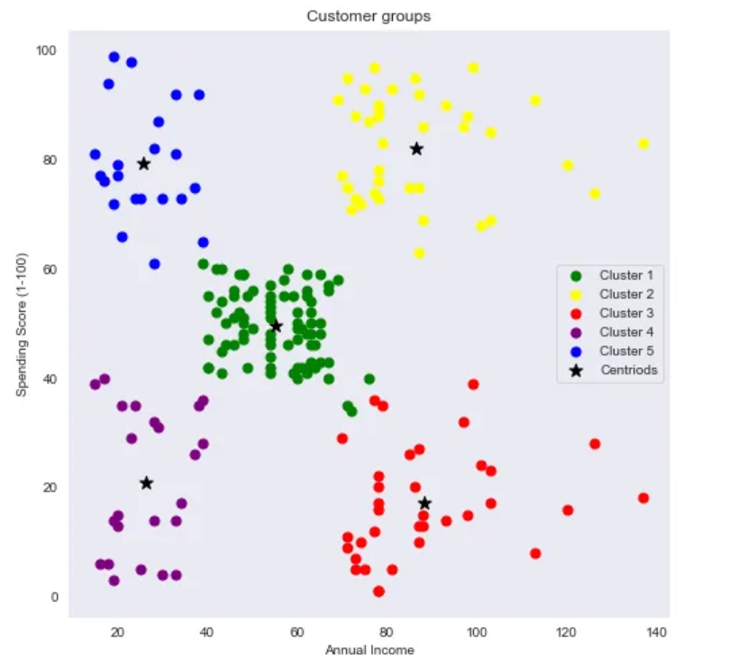
K-Mean outcome:

